Slide 1
Sentiment Analysis Using BERT and Multi-Instance Learning
Iryna Burak
Pablo Restrepo
June 8, 2020

Slide 2
Presentation Overview: What did we do on the last 2 weeks?
Cross-lingual zero shot learning:
1.1 Exploring our Amazon reviews dataset in German.
1.2 Generating multilingual BERT embeddings for our data.
1.3 Exploring other multilingual embedding options.
Trying to fine-tune our network.
2.1 Running our MilNet with BERT base embeddings.
2.2 Running our MilNet with BERT multilingual embeddings.
Plan for the next two weeks.
References.
‹#›

Slide 3

1. Cross-lingual zero shot learning:
‹#›

Slide 4
1. Cross-lingual zero shot learning:
1.1 Exploring our Amazon reviews dataset in German:
Amazon reviews dataset in German.
678.993 reviews.
34 categories including:
Home Improvement
Books
Digital_Video_Download,
Watches
Mobile_Apps
...
‹#›

Slide 5
1. Cross-lingual zero shot learning:
1.1 Exploring our Amazon reviews dataset in German:
As training data, we are using amazon reviews in English from the following categories:
Grocery and Gourmet Food
Health and Personal Care
Beauty
From the 34 categories in our dataset in German, the most relevant for us are:
Health & Personal Care
Personal_Care_Appliances
Beauty
Grocery
‹#›

Slide 6
1. Cross-lingual zero shot learning:
1.1 Exploring our Amazon reviews dataset in German:
Number of instances per selected category:
Personal_Care_Appliances 411
Health & Personal Care 37
Grocery 2
Beauty 1
Total number of instances: 451
Total number of instances after splitting the comments in sentences (using NLTK): 1.762 (1.35% of our total data)
Number of sentences in our dataset in English: 129.867
Sentiment | Instances | Percentage
negative | 60 | 13.3%
neutral | 40 | 8.8%
positive | 351 | 77.8%
‹#›

Slide 7
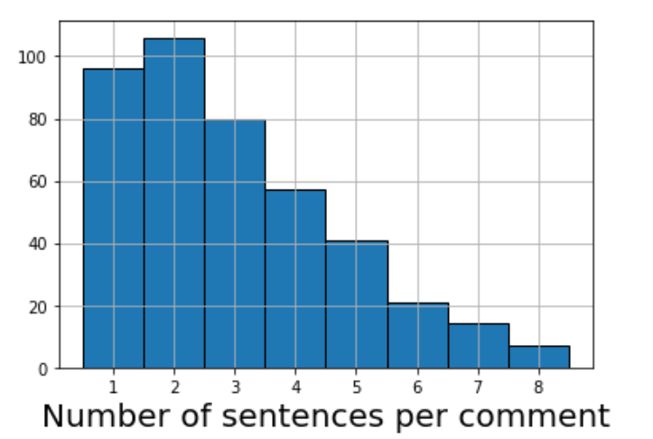
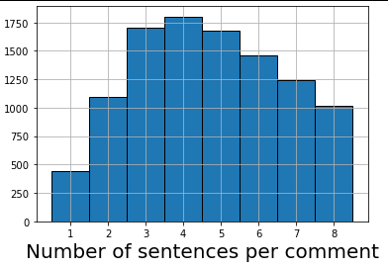
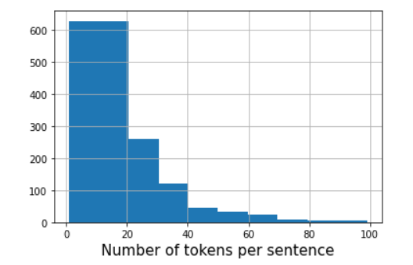
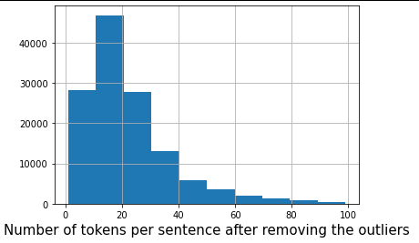
1. Cross-lingual zero shot learning:
1.1 Exploring our Amazon reviews dataset in German:
Dataset in German:
Dataset in English (training data):
‹#›
‹#›

Slide 8

1. Cross-lingual zero shot learning:
1.2 Generating multilingual BERT embeddings for our data.
Number of instances per selected category:
Model: “BERT-Base, Multilingual Cased” (recommended model for multilingual models)
Pooling Strategy: Reduce Mean
Pooling Layer = -2
767 values per sentence
file size: 2.1 gb
‹#›

Slide 9
1. Cross-lingual zero shot learning:
1.3 Exploring other multilingual embedding options.
Bert Multilingual.
XLM: improved version of BERT to achieve state-of-the-art results in classification and translation tasks.
XLM-RoBERTa (Facebook AI): provides strong gains over previously released multi-lingual models like mBERT or XLM on downstream tasks like classification, sequence labeling and question answering
XLING: Concatenated Power Mean Embeddings as Universal Cross-Lingual Sentence Representations
XLNet: Generalized Autoregressive Pretraining for Language Understanding.
‹#›

Slide 10
2. Trying to fine-tune the model
2.1 Running our MilNet with BERT base embeddings.
Added one additional linear layer to convert 768-dim embeddings to 300-dim embeddings.
Dropout makes the training process unstable.
Downsampling factor: 0.15
sentiment | before | after
negative | 1372 | 1372
neutral | 1533 | 1533
positive | 12605 | 1951
‹#›

Slide 11
2. Trying to fine-tune the model
2.1 Running our MilNet with BERT base embeddings.
Amazon
metric | amazon | organic
F1 (micro) | 0.662 | 0.464
F1 (macro) | 0.643 | 0.449
True | - | 0 | +
- | 58 | 54 | 13
0 | 22 | 109 | 16
+ | 7 | 50 | 150
Previous results
Organic dataset
metric | amazon | organic
F1 (micro) | 0.672 | 0.450
F1 (macro) | 0.530 | 0.447
True | - | 0 | +
- | 540 | 876 | 42
0 | 361 | 1295 | 317
+ | 178 | 909 | 526
‹#›

Slide 12
2. Trying to fine-tune the model
2.2 Running our MilNet with BERT multilingual embeddings.
Base BERT
metric | amazon-german | amazon-english | organic
F1 (micro) | - | 0.662 | 0.464
F1 (macro) | - | 0.643 | 0.449
Multilingual BERT
metric | amazon-german | amazon-english | organic
F1 (micro) | 0.47 | 0.585 | 0.430
F1 (macro) | 0.40 | 0.557 | 0.430
‹#›

Slide 13
3. Plan for the next two weeks:
Update our baselines to work with data in German
Generate embeddings for our data using different techniques (XLM-RoBERTa,XLING,XLNet).
Train our MilNet using different embeddings and compare results.
Try to improve our numbers as much as possible.
‹#›

Slide 14
4. References
Jacob Devlin, Ming-Wei Chang, Kenton Lee, Kristina Toutanova: “BERT: Pre-training of Deep Bidirectional Transformers for Language Understanding”, 2018; [http://arxiv.org/abs/1810.04805 arXiv:1810.04805].
Multi-lingual models, Huggingface, https://huggingface.co/transformers/multilingual.html
Alexis Conneau, Kartikay Khandelwal, Naman Goyal, Vishrav Chaudhary, Guillaume Wenzek, Francisco Guzmán, Edouard Grave, Myle Ott, Luke Zettlemoyer, Veselin Stoyanov: “Unsupervised Cross-lingual Representation Learning at Scale”, 2019; [http://arxiv.org/abs/1911.02116 arXiv:1911.02116].
Andreas Rücklé, Steffen Eger, Maxime Peyrard, Iryna Gurevych: “Concatenated Power Mean Word Embeddings as Universal Cross-Lingual Sentence Representations”, 2018; [http://arxiv.org/abs/1803.01400 arXiv:1803.01400].
Zhilin Yang, Zihang Dai, Yiming Yang, Jaime Carbonell, Ruslan Salakhutdinov, Quoc V. Le: “XLNet: Generalized Autoregressive Pretraining for Language Understanding”, 2019; [http://arxiv.org/abs/1906.08237 arXiv:1906.08237].
‹#›

